Slide 1

#LifeKoKaroLift
Be sincere, not serious !

Slide 2



Course : Experiential Learning
Session On : Software Testing

Slide 3
Building Right Thing
Vs
Building Thing Right
Notes:
https://www.youtube.com/watch?v=2NFH3VC6LNs

Slide 4
Types Of Testing?

Slide 5
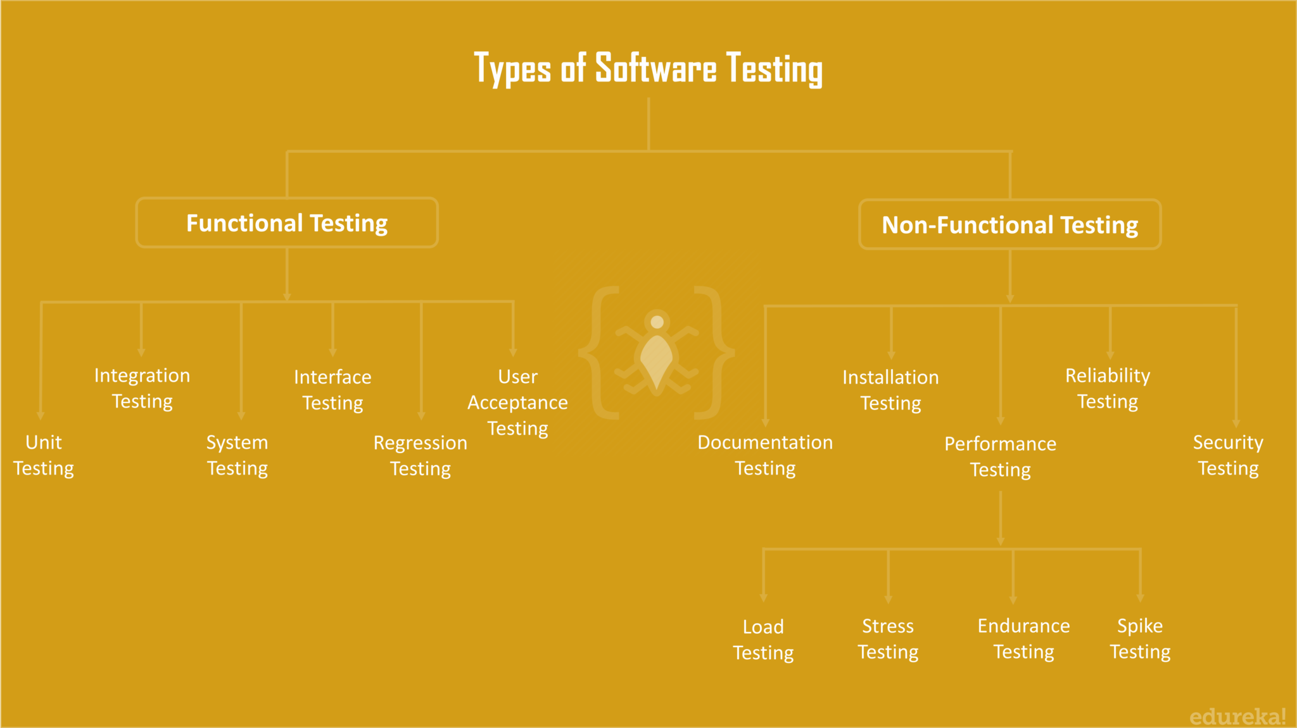
SDLC

Slide 6
Application Lifecycle
Where To Test?

Slide 7
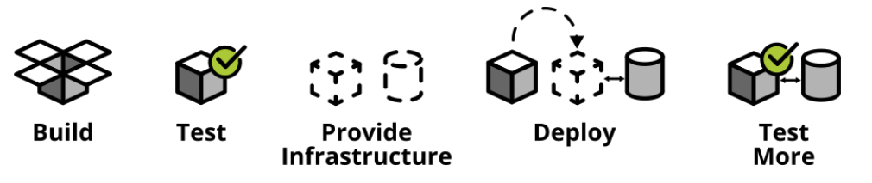
Application Lifecycle

Slide 8
How much should we test?

Slide 9
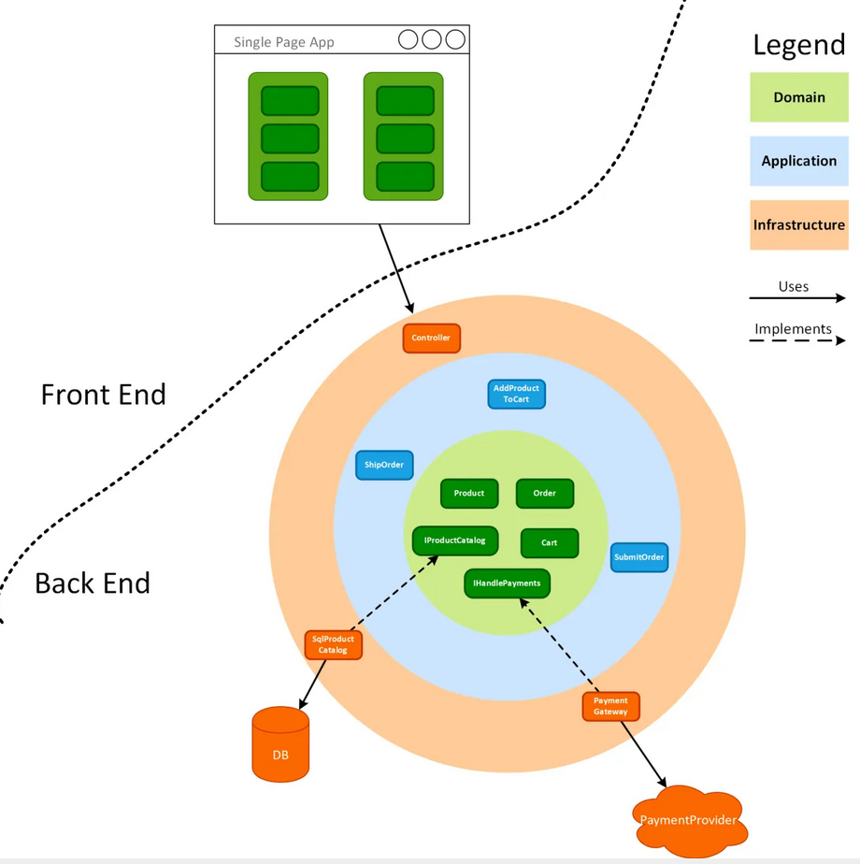
High Level Arch

Slide 10
Unit Test
Notes:
What makes unit?
Intent

Slide 11
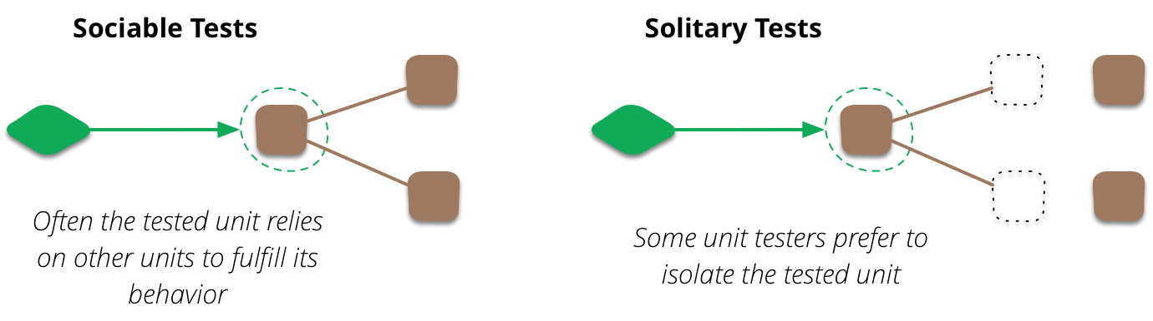
What makes a unit?
Notes:
What makes unit?

Slide 12
Characteristics of unit test
Fast
Independent
Reliable
Notes:
What makes unit?

Slide 13
Best Practices
Arrange, Act, Assert
One Assert Per Test Method
Avoid Test Interdependence
Recognize Test Setup Pain as a Smell
Add Them to the Build
Notes:
What makes unit?

Slide 14
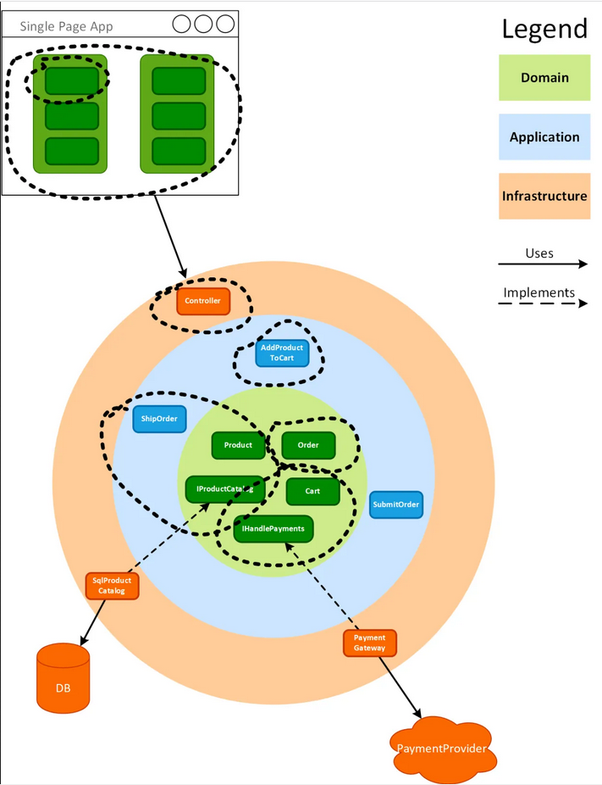
Unit Test

Slide 15
Integration Test
Notes:
What makes unit?

Slide 16
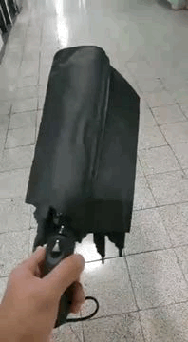
What’s wrong?
Notes:
What makes unit?

Slide 17
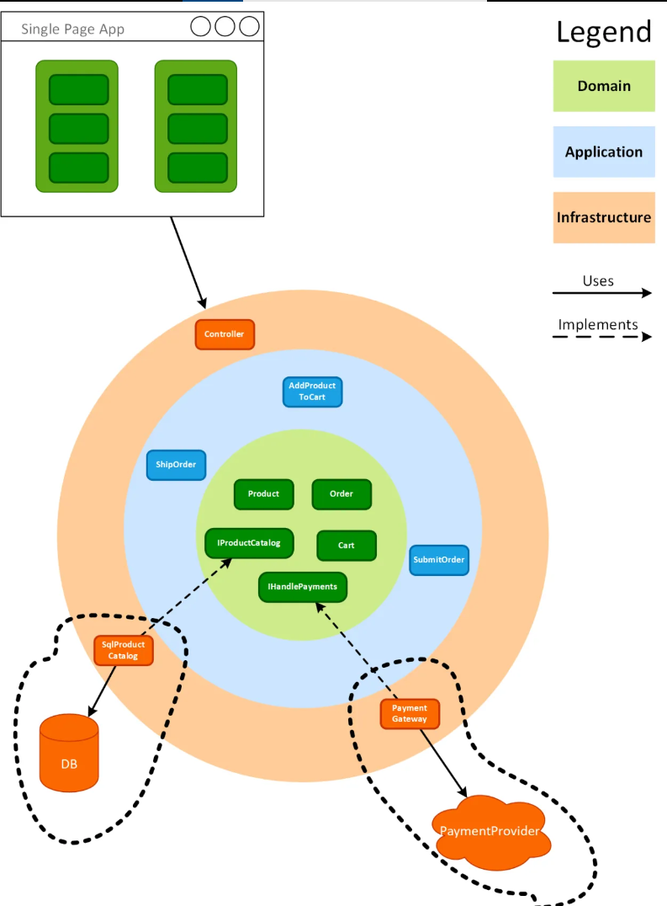
Integration Test

Slide 18
E2E Test
Notes:
What makes unit?

Slide 19
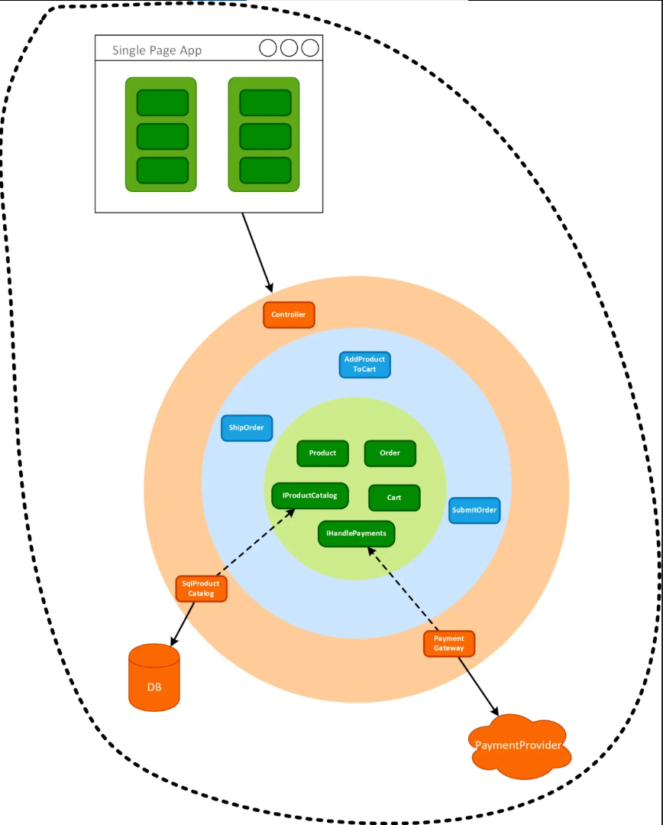
E2E Test

Slide 20
Let’s see it in action!
Notes:
What makes unit?

Slide 21
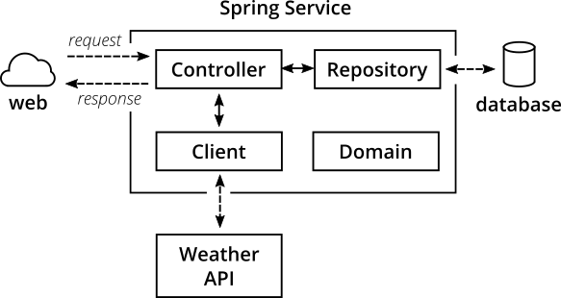
Testing Pyramid

Slide 22
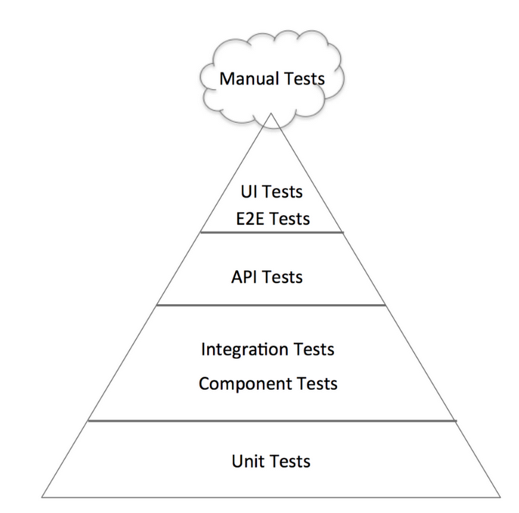
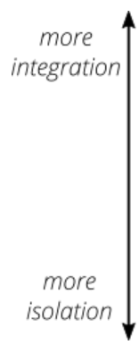
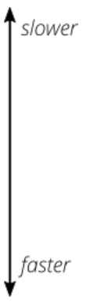
Testing Pyramid

Slide 23
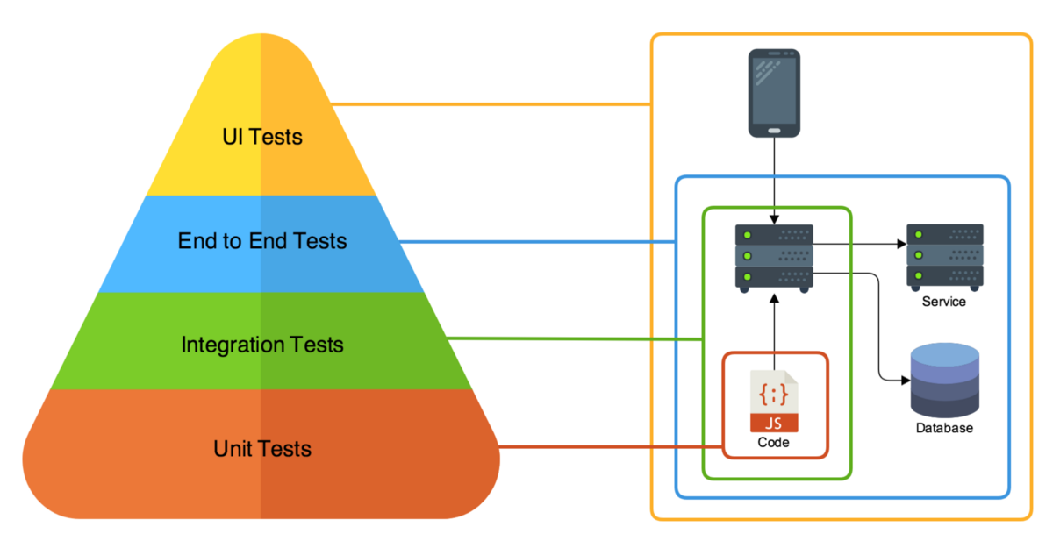
Testing Pyramid

Slide 24

There are no silly questions :)

Slide 25
#LifeKoKaroLift
Thank You!

